Slide 1

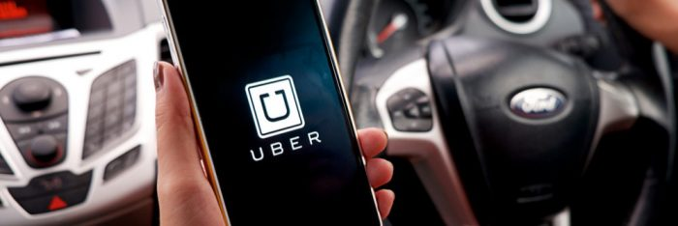

DR B R AMBEDKAR NATIONAL INSTITUTE OF TECHNOLOGY JALANDHAR PUNJAB -144011
INDUSTRIAL TRAINING PRESENTATION
ON
CASE STUDY ON UBER SUPPLY DEMAND GAP
SUBMITTED BY-
ASTITVA SRIVASTAVA

Slide 2
Uber Supply Demand Gap Assignment

Slide 3

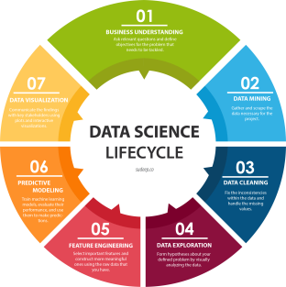

SOFTWARE & LANGUAGE USED
Jupyter Notebook
Data Science Analysis
Python Libraries-
Numpy
SciPy
Pandas
Matplotlib

Slide 4
Data Exploration
Data set contains 6 columns:
Request.id
Pickup.point
Driver.id
Status
Request.timestamp
Drop.timestamp
Problem Statement: Find out the supply demand gap and suggest way to improve the situation
Based on the problem statement, we should focus on pickup point, status and driver id.

Slide 5
Data Cleaning and Manipulation
Possible data inconsistencies:
Duplicate values of Request ID
NA values in the columns of interest
Other Issues:
Request time stamp is object here. Convert it to date time format.
Dates are separated by “/” and “-”. Make this consistent for ease of data analysis.

Slide 6
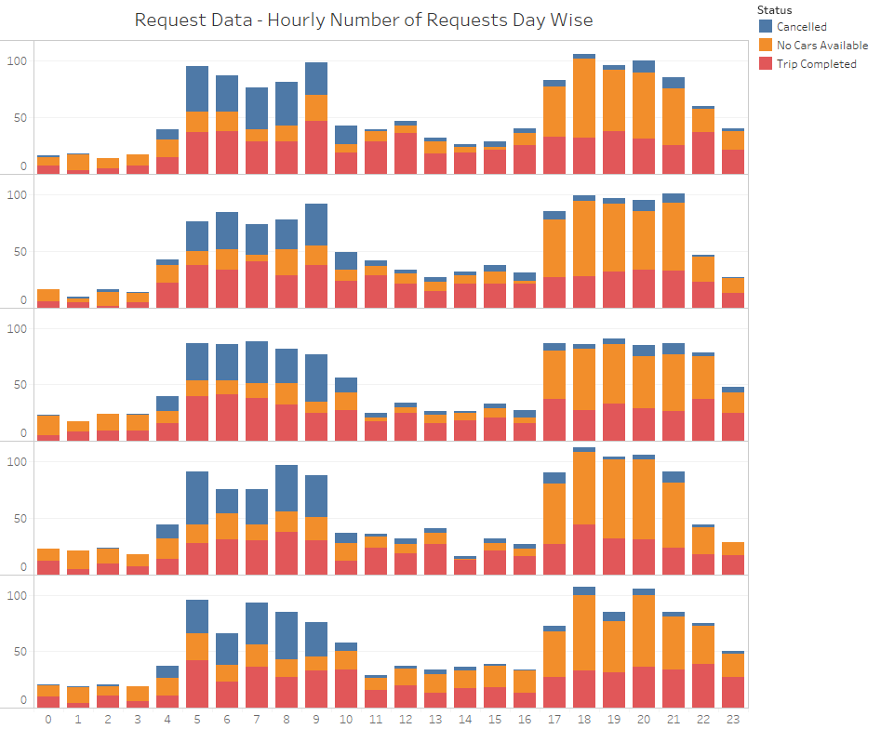
Analysing Trends For Each Day
The pattern of requests is common for all the days for the status of requests.
Number of Requests

Slide 7
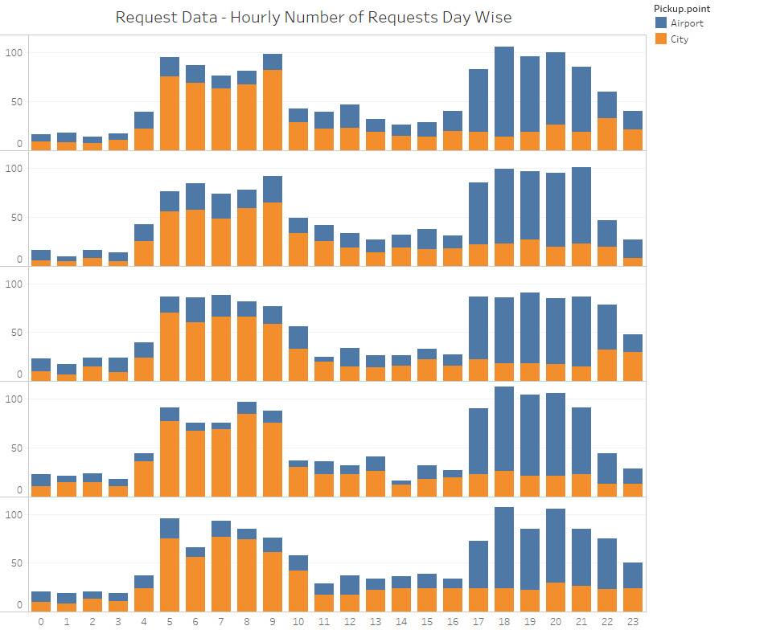
Analysing Trends For Each Day
The pattern of requests is common even for all the days for the pick up point where the requests have been generated.
Number of Requests

Slide 8
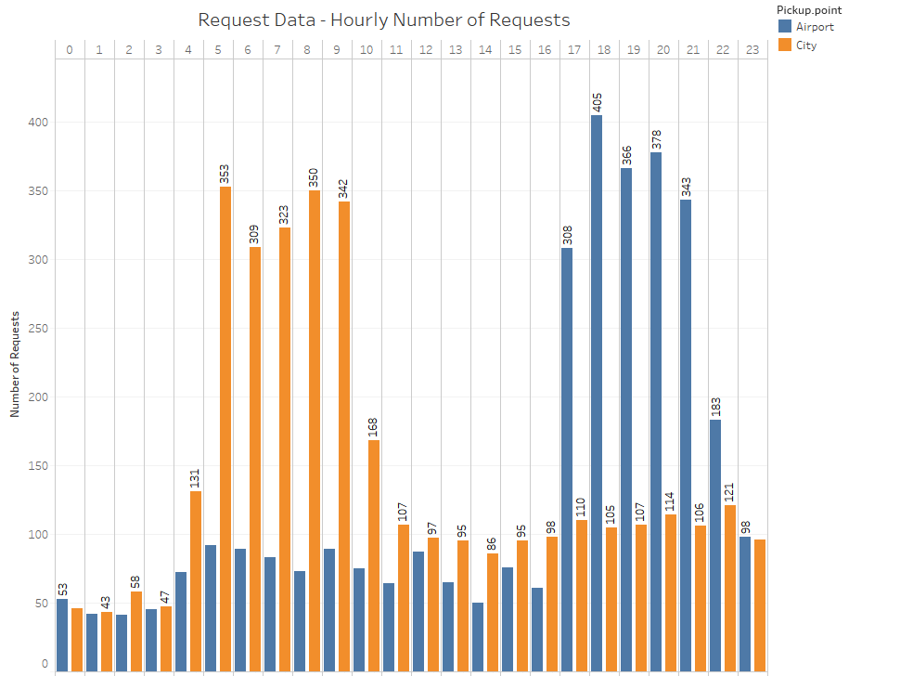
Combining Data For All Days
Previous graphs show that all the days show common trends.
Hence the number of requests can be clubbed together for further analysis.
Conclusion:
Number of trips in morning are high from the city
Number of trips from the evening are high from the airport

Slide 9
Binning Time Into 5 Categories
Requests generated are divided into 5 homogenous categories based on the time of request
Time
Category
12 AM – 5 AM
Pre_Morning
5 AM – 10 AM Morning_Rush
10 AM – 5 PM Day_Time
5 PM – 10 PM Evening_Rush
10 PM – 12 AM Late_Night

Slide 10
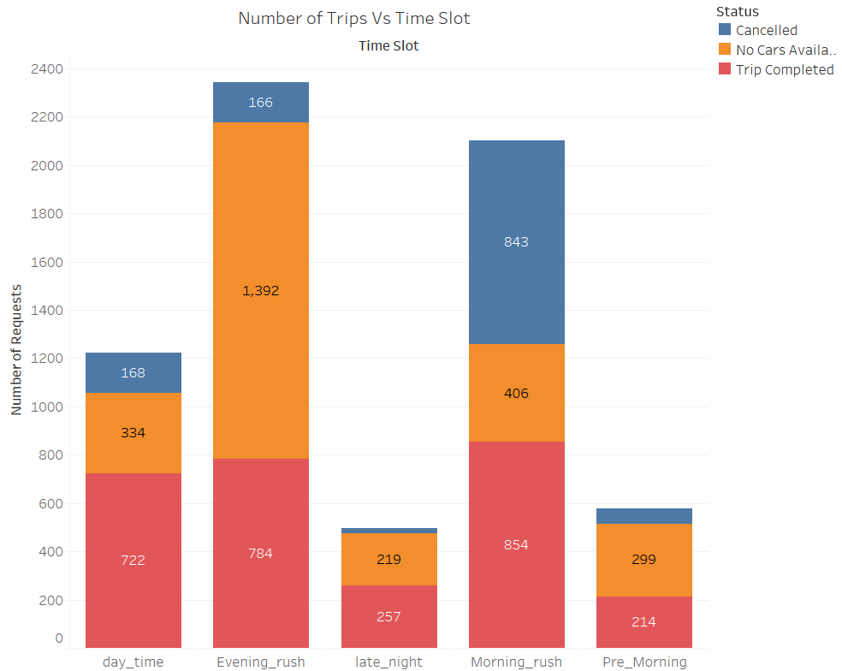
Problem Identification – Morning and Evening
Graph clearly shows that the major problems are:
Cancelled trips during the morning rush
Unavailability of cars during evening rush

Slide 11
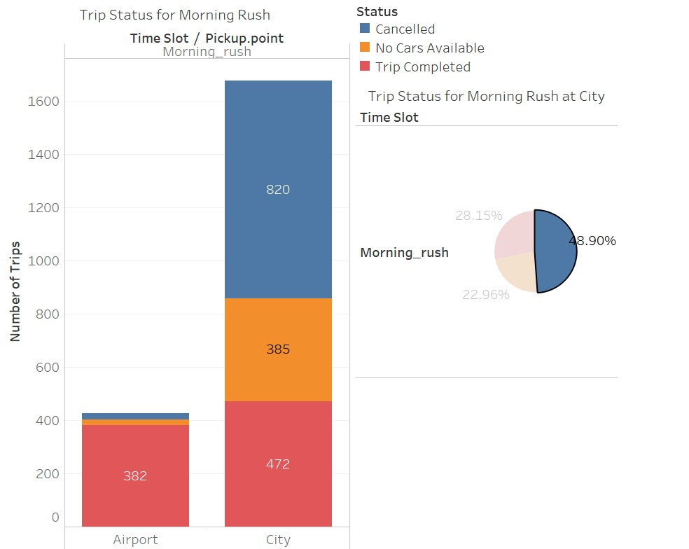
Cancelled trips - 50 % of total trips from city
The supply from the city is 472, while the demand is 472 + 285
+ 820 = 1677 .
The difference between the demand and the supply is 1205.

Slide 12
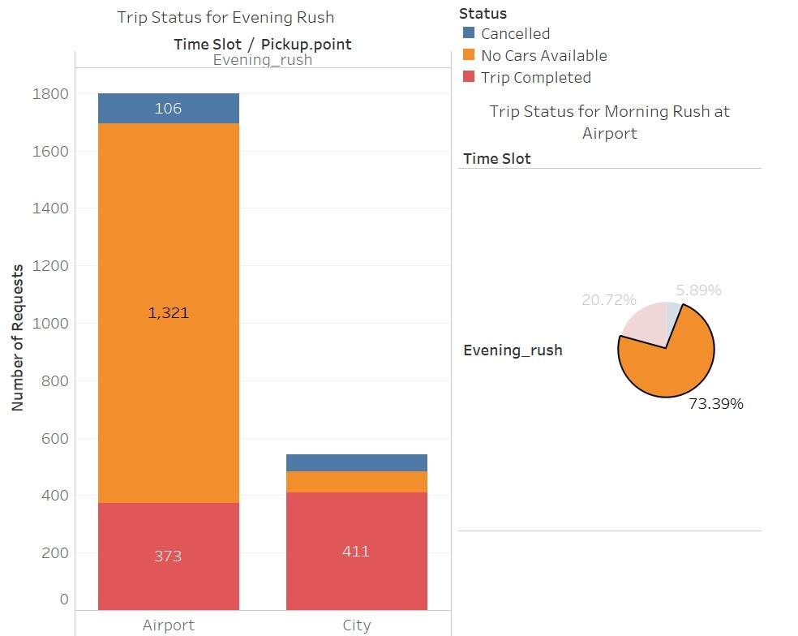
No Cars - 70 % of total trips from airport
The supply from the airport is 373, while the demand is 373 + 1321 + 106 = 1800.
The difference between the demand and the supply is 1427.

Slide 13
Recommendations
For the trips in the morning, drivers can be incentivised to make those trips.
They could be given a bonus for each trip they complete from the city to the airport in the morning rush. This will ensure that less number of trips are cancelled.
Uber can pay for the gas mileage of drivers to come back to the city without a ride.
Uber can increase the demand at the airport to reduce idle time – by increased marketing and price cuts for the passengers
For the evening, since the number of drivers is less, some of the ways are:
Drivers can again be given a bonus to complete a trip from the airport in the evening. This will ensure that the supply increases at the airport.
Uber can also pay drivers to come without a passenger to the airport
Another innovative way can be to pool the rides of passengers so that lesser number of cars can serve more passengers.

Slide 14


